Slide 1
CSE431 The ChatBot Feels You – A Counseling Service Using Emotional Response Generation Salman Mostafiz Chowdhury(17101149) Md. Shamiul Islam(17301108) Md. Nazmur Sakib(17301124) Ali Ahammed Rohid(17101361) S. M. Bayazid Hossain(16101072) Md. Sadiqul Islam Sakif(17301137)

Slide 2

Paper Content
Abstract
Introduction
Related works done so far
Emotion response generation
Conclusion
Emotion Recognition
Chat Assistant
Emotion Recognition Based on NLP
Personalize Response Generation

Slide 3
Overview
Counseling Chat-Bot
For cognitive behavioral therapy
Connecting to real therapists

Slide 4
INTRODUCTION
Emotional recognition of human has been a long research topic.
Artificial intelligence(AI) methods are adequate approach.
Varies approaches:
Static image processing – convolution neural network
Temporal time domain – recurrent neural network
Machine translation – attention network
Hybrid approach for multi-modal classification improves result for emotion recognition significantly.

Slide 5
Not many applications applies the brand-new emotion recongnition techniques.
Apple Siri, Google now, Samsung S-Voice
The services just apply very simple natural language processing (NLP) techniques.
In this paper, a novel chatbot application is introduced which provide mental healthcare counseling service based on above natural language processing and emotion recognition methods in chat assistant platform which consist of the user sensitive emotion and context extraction.

Slide 6
Related Works
Emotion Recognition:
Almost 10 features that indicates the emotional state of the user through text, image, audio and video.
Seven emotional states like happiness, anger, sadness, fear, surprise disgust and neutral which are determined by the contextual and behavioral user patterns.
B. K. Kim and J. Roy showed robust face expression recognition which follows deep CNNs method.
L. Chao and J. Tao utilized the soft attention mechanism through temporal audio and visual streams.
Emotion embedding vectors locates the perception attentions which follows RNN algorithm.
Existing emotion recognition methods has limitations due to single feature only. Need integrating multi-modal information for better recognition.

Slide 7
Related Works
Chat Assistant for Mental Healthcare:
Chatbot must have capability to analyze the natural language dialogue, because chatbot generate responses by it’s own from the user’s input.
Deep interaction model can recognizes the complex and long term emotions.
Continuous various conversations can be generated through the emotional intelligent assistant.
Chatbot need to learn the characteristics and emotional state of the individual.
Emotional intelligent assistant learn opinions and emotions of humans and communicate with them continuously.
A. Hommersom and P. J. Lucas introduces a smart mobile healthcare assistant where patient communicate with doctor.

Slide 8
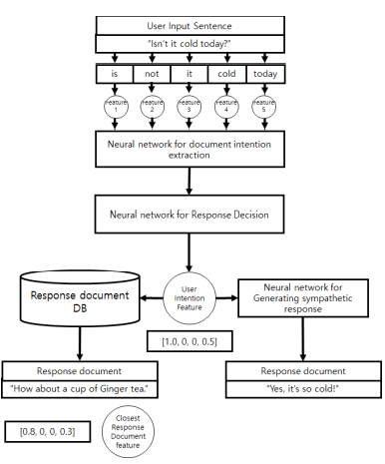
RESPONSE GENERATION
Consist of:
1.feature extraction
2.response decision
3. generating sympathetic response
4.generating informative response.

Slide 9
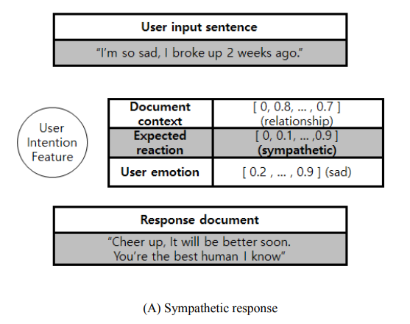
Personalized Response Generation
Personalizing response based different factors like person’s age, gender etc.
Dataset for User Intention
consists of document context and user emotion.

Slide 10
Emotional Recognition Based on NLP
Vectorizes dataset
GRU-based sentences analysis
8-kind of emotions to represent
Track user emotion log
Pre-recognize state
Collect data from social network
Maintaining ethical aspects of human

Slide 11
Provide conversational mental healthcare service based on emotion recognition
Future works

Slide 12
Thank You

